Slide 1

Agenda
What is NLP?
Use Cases of NLP
Core Terminologies
NLP Libraries
NLP Popular Tools
Data Science Workflow - Example
NLP
Kristina Radivojevic
11/08/2021

Slide 2
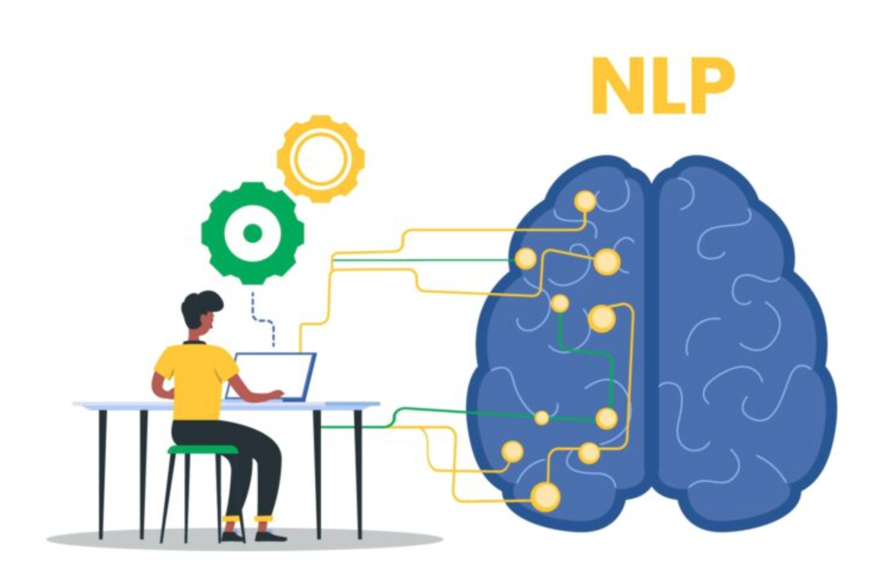
What is NLP?
Natural Language Processing
NLP is a branch of artificial intelligence that helps computers understand, interpret and manipulate human language
Subcategories include Natural Language Generation (NLG) - a computer’s ability to create communication of its own - and Natural Language Understanding (NLU) - the ability to understand slang, mispronunciations, misspellings, and other variants in language
NLP = NLG + NLU

Slide 3

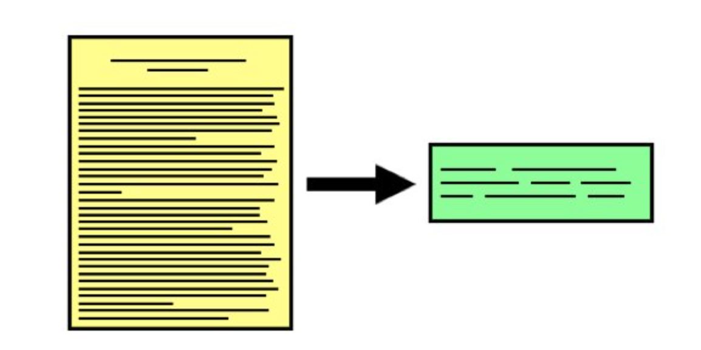


Uses Cases of NLP
Text Summarization
Voice Assistants
Sentiment Analysis
Spam Filters
Grammar Correction Software
Social Media Monitoring Tools
Machine Translation
Automated Question Answering
...

Slide 4
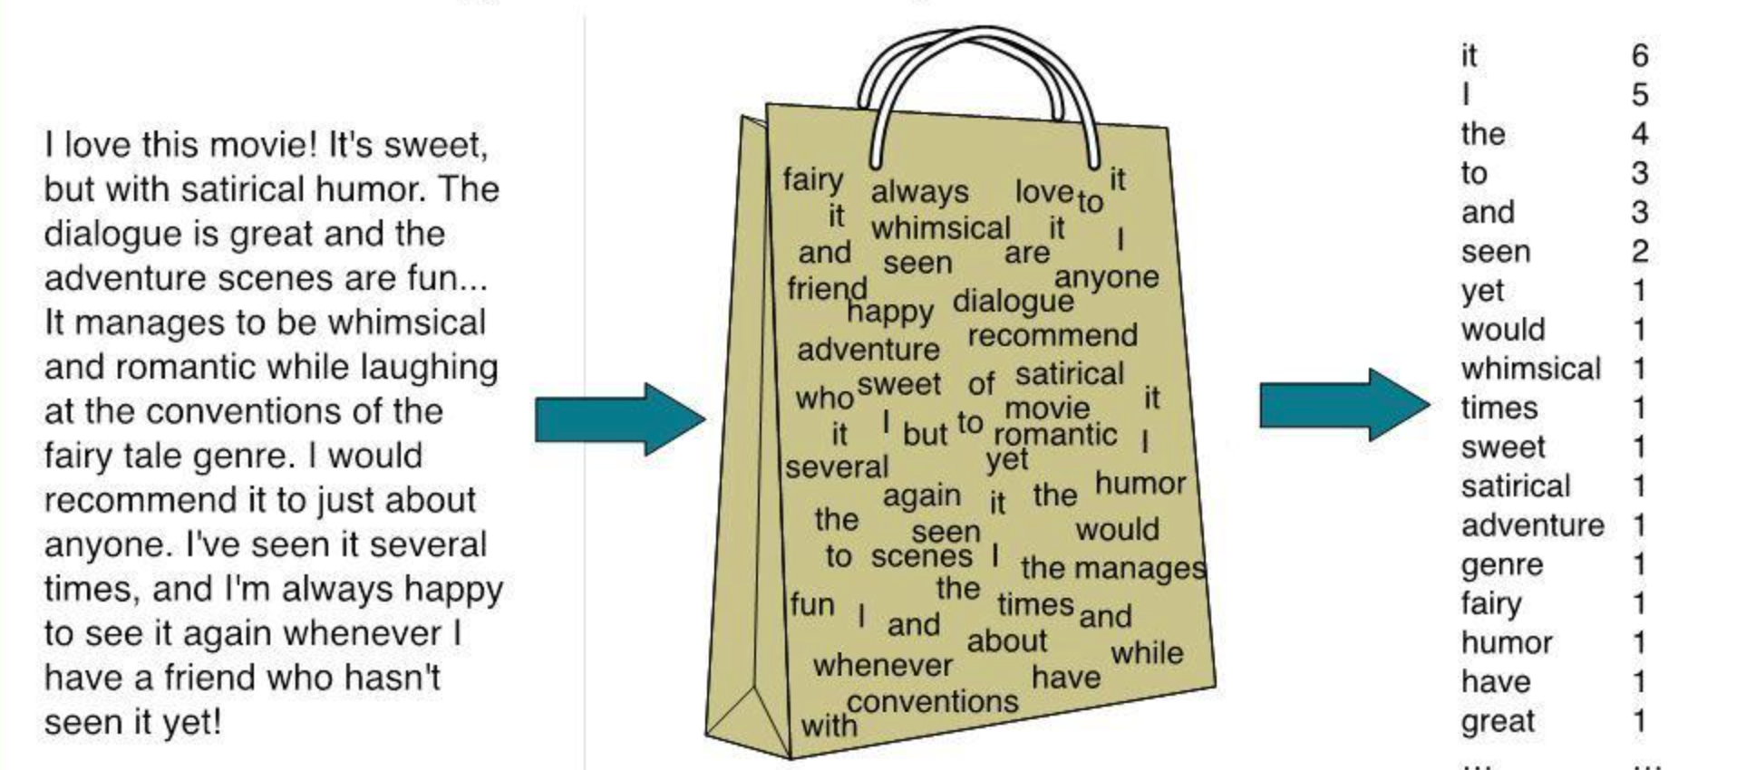
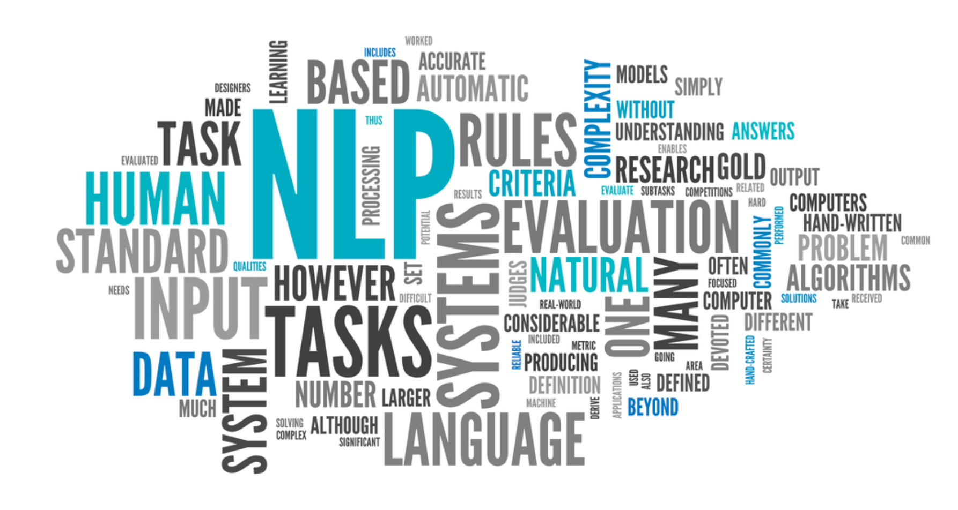
Core Terminologies
Corpus - large collection of data
Parsing - analyzes and works out the structure of sentences in grammar
Stemming and Lemmatization - reducing a word to its original meaning
Tokenization - split text into smaller pieces (aka tokens)
Stop words - words that have very little meaning
A bag of words model - a simple format that ignores order
Word Cloud - visual representation of text data
Document-Term Matrix - mathematical matrix that describes the frequency of terms that occur in a collection of documents
Countvectorizer - a way to make DTM (Document-Term Matrix)

Slide 5


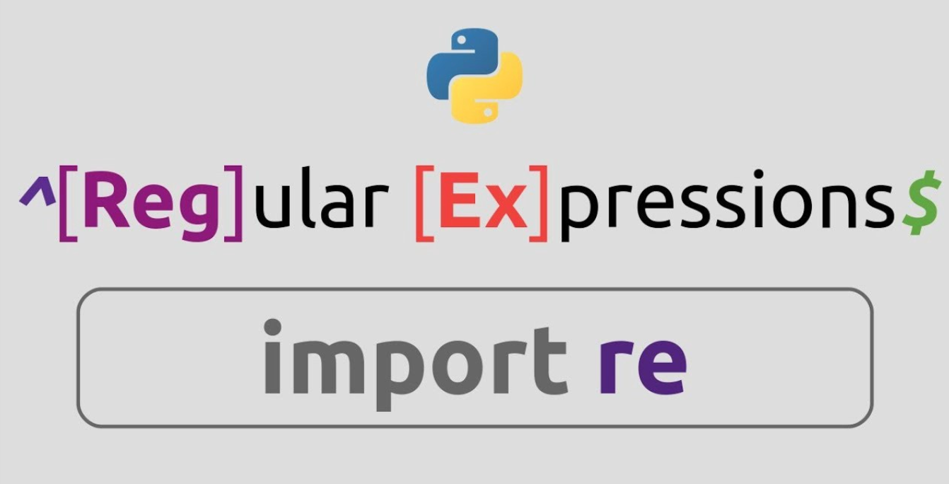

NLP Libraries
pandas - Python library for data analysis
re - Python library for regular expressions
scikit-learn - Python library for machine learning
request - allows sending HTTP requests using Python
beautifulSoup - Python library for pulling data out of XML and HTML files

Slide 6
NLP Popular Tools
nltk - supports tasks such as classification, stemming, tagging, parsing, semantic reasoning and tokenization
TextBlob - provides some additional functionality, such as ruled based sentiment scores, fixes typos; finds all of the words and phrases that it can assign polarity (-1, +1) and subjectivity (0 - objective -- fact, 1 - subjective -- opinion) to, and averages all of them together;
gensim - largery deals with topic modeling tasks using algorithms like Latent Dirichlet Allocation (LDA)
spaCy - for production usage; it’s written in Cython
PyTorch-NLP - used for neural network layers, datasets, and text processing modules
OpenNLP - it is hosted by the Apache Foundation; it covers all the common processing components of NLP
CoreNLP - it is written in Java and it’s production-ready, enterprise solution; it performs a variety of operations like sentiment analysis, parts-of-speech tagging, named-entity recognition

Slide 7
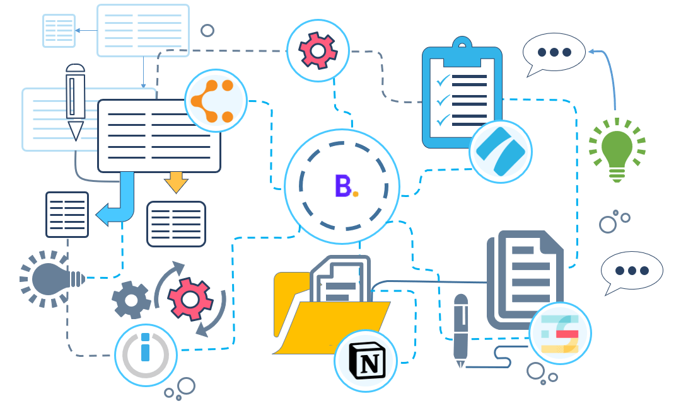
Data Science Workflow - Example
Start with the Question
Get and Clean the Data
Perform EDA (Exploratory Data Analysis)
Apply NLP Techniques (Bag of Words, Tokenization, Stop Words, Stemming, Lemmatization, Topic Modeling, Sentiment Analysis, Text Generation…)
Share Insights

Slide 8

Questions?

